Slide 1
DATA ANALYSIS
MUKESH MANOHAR
BANDARU ARVIND MOHIT
BSVS ROHIT
TARUN KOTTANA
AKHILESH REDDY
SRUTHI

Slide 2


IPL DATA SET

Slide 3
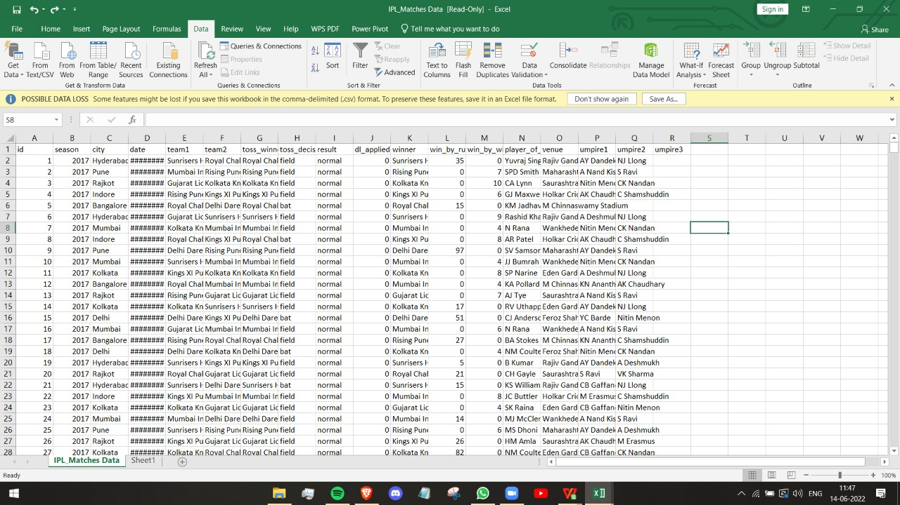

Slide 4
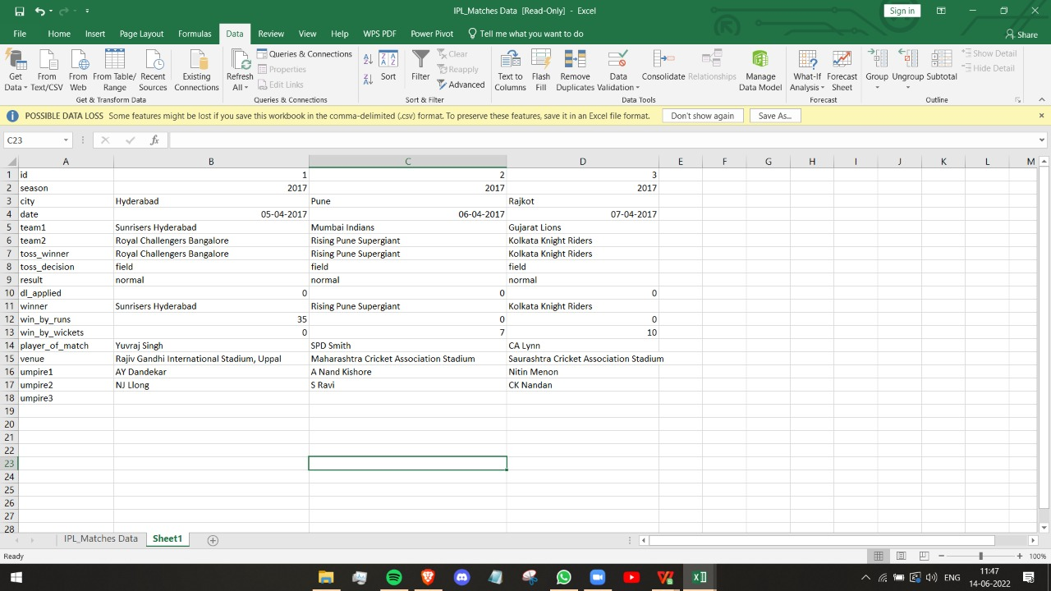

Slide 5
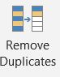
REMOVING DUPLICATES
WE HAVE TO SELECT THE DATA AND THEN USE THE IN BUILT FUNCTION THAT IS REMOVE DUPLICATES TO REMOVE ALL THE DUPLICATE DATA THAT IS PRESENT.
When you use the Remove Duplicates feature, the duplicate data will be permanently deleted. Before you delete the duplicates, it's a good idea to copy the original data to another worksheet so you don't accidentally lose any information. Select the range of cells that has duplicate values you want to remove.

Slide 6
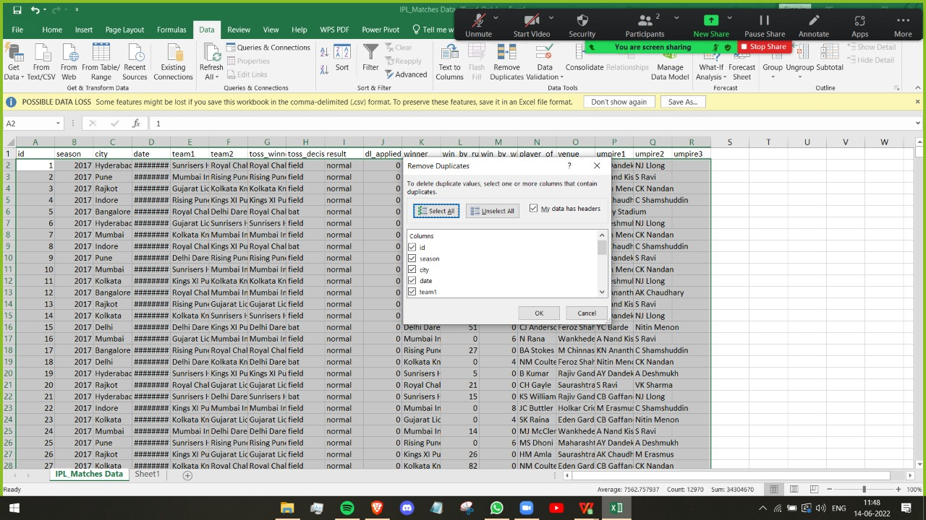

Slide 7
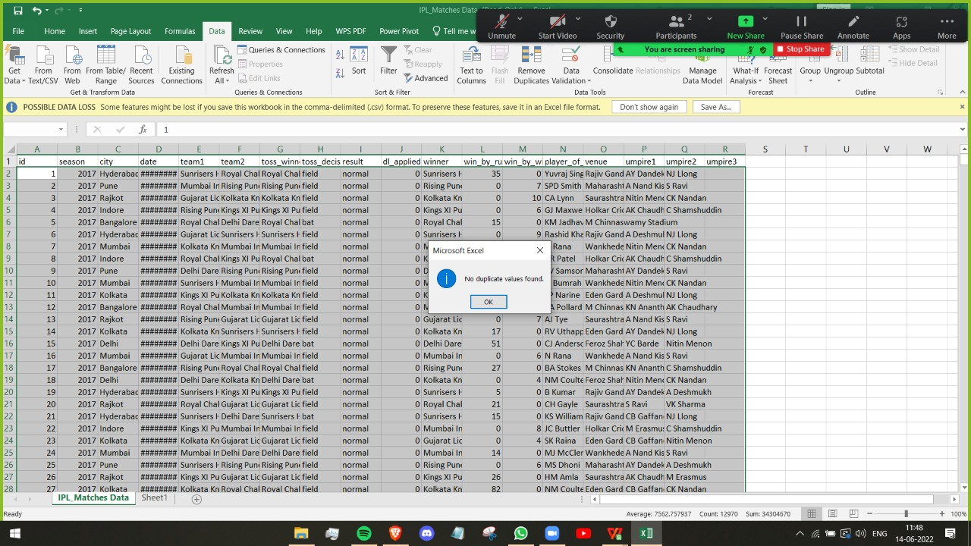

Slide 8
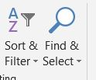
FIND AND REPLACE
To replace text or numbers, press Ctrl+H, or go to Home > Find & Select > Replace.
In the Find what box, type the text or numbers you want to find.
In the Replace with box, enter the text or numbers you want to use to replace the search text.
Click Replace or Replace All. ...
You can further define your search if needed:

Slide 9
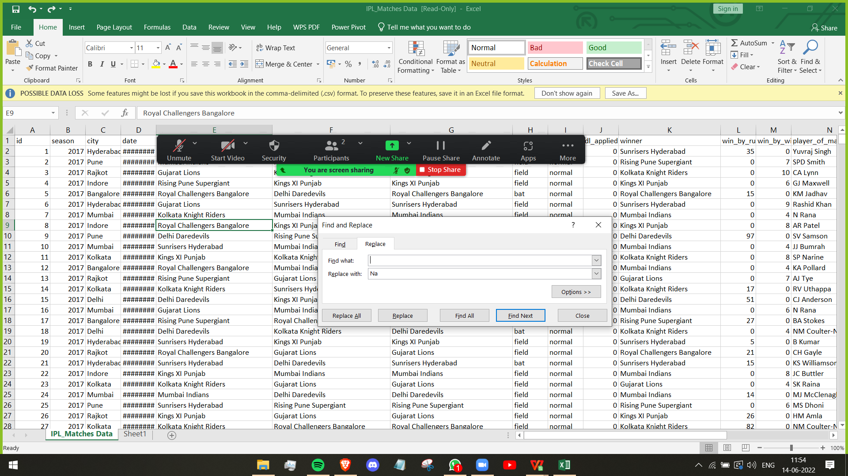

Slide 10
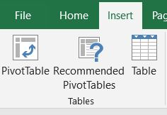
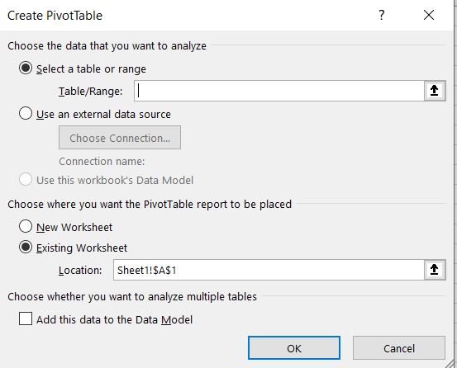
PIVOT TOOL
PIVOT TABLE ANALYZE
To create PivotTables, ensure the first row has headers.
Click the table.
Click the INSERT tab on the Ribbon.
Click PivotTable in the Tables group. The PivotTable dialog box appears the Table / Range Box, type the table name.
Click New Worksheet to tell Excel where to keep the PivotTable.
Click New Worksheet to tell Excel where to keep the PivotTable.
Click OK.

Slide 11
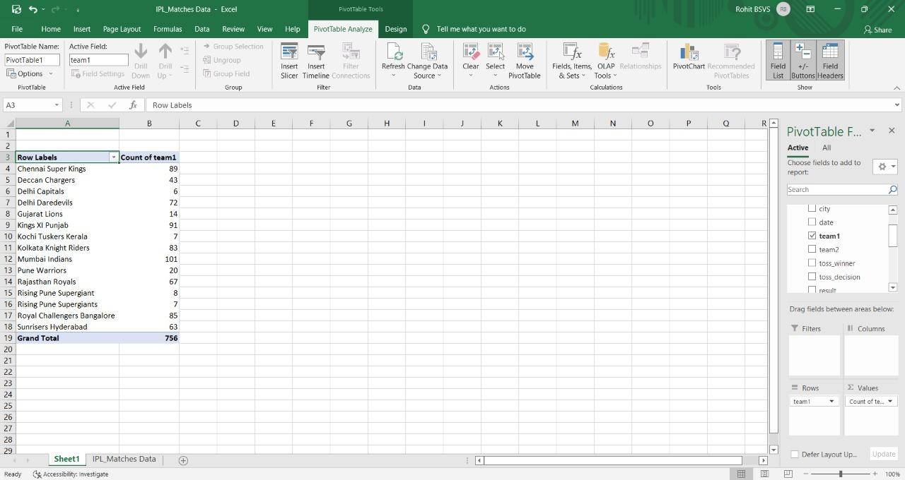

Slide 12
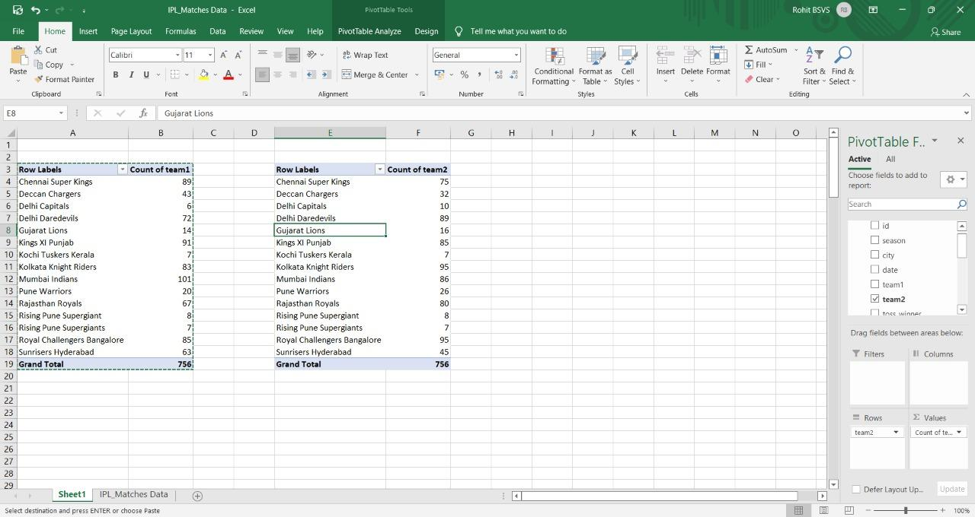

Slide 13
COUNTIF
The COUNTIF function is a premade function in Excel, which counts cells as specified.
COUNTIF Function
Select a cell.
Type =COUNTIF.
Double click the COUNTIF command.
Select a range.
Type ,
Select a cell (the criteria, the value that you want to count)
Hit enter.

Slide 14
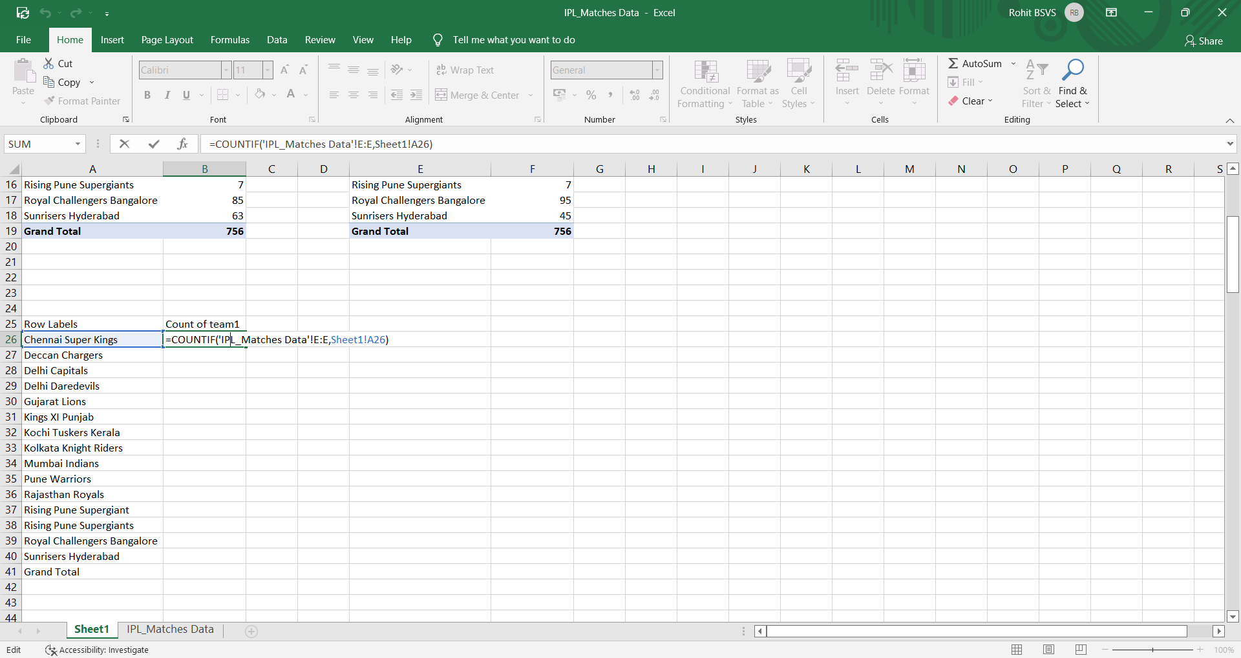

Slide 15
SUM
If you need to sum a column or row of numbers, let Excel do the math for you. Select a cell next to the numbers you want to sum, click AutoSum on the Home tab, press Enter, and you're done. When you click AutoSum, Excel automatically enters a formula (that uses the SUM function) to sum the numbers.

Slide 16
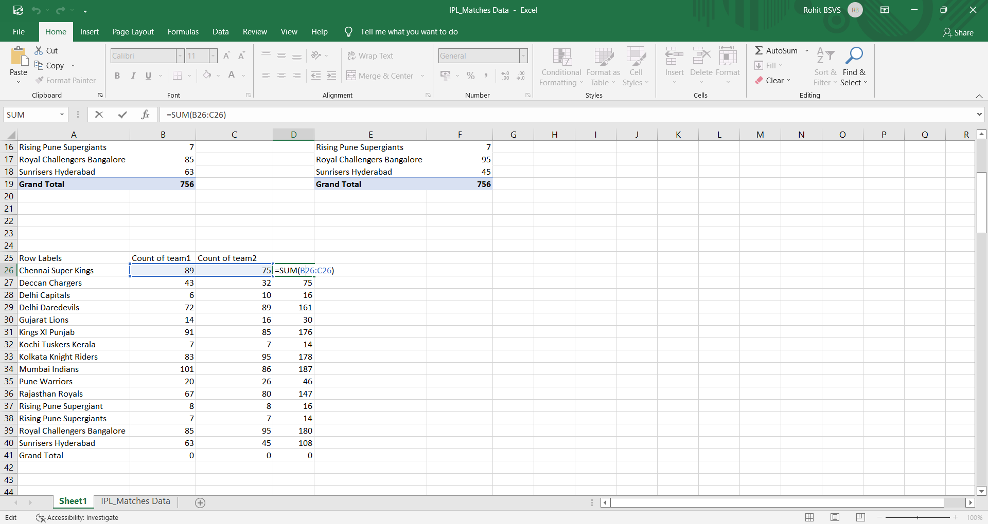

Slide 17
VLOOKUP
In its simplest form, the VLOOKUP function says: =VLOOKUP(What you want to look up, where you want to look for it, the column number in the range containing the value to return, return an Approximate or Exact match – indicated as 1/TRUE, or 0/FALSE).

Slide 18
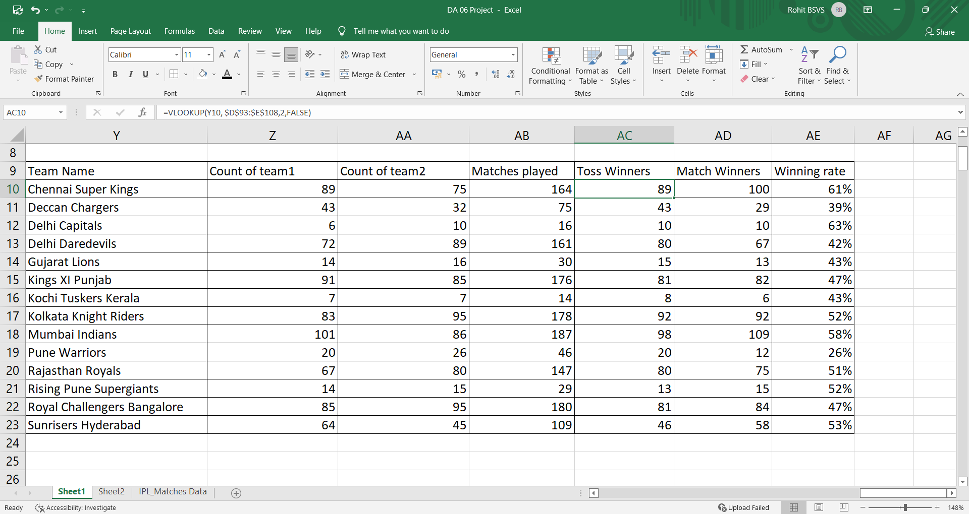

Slide 19
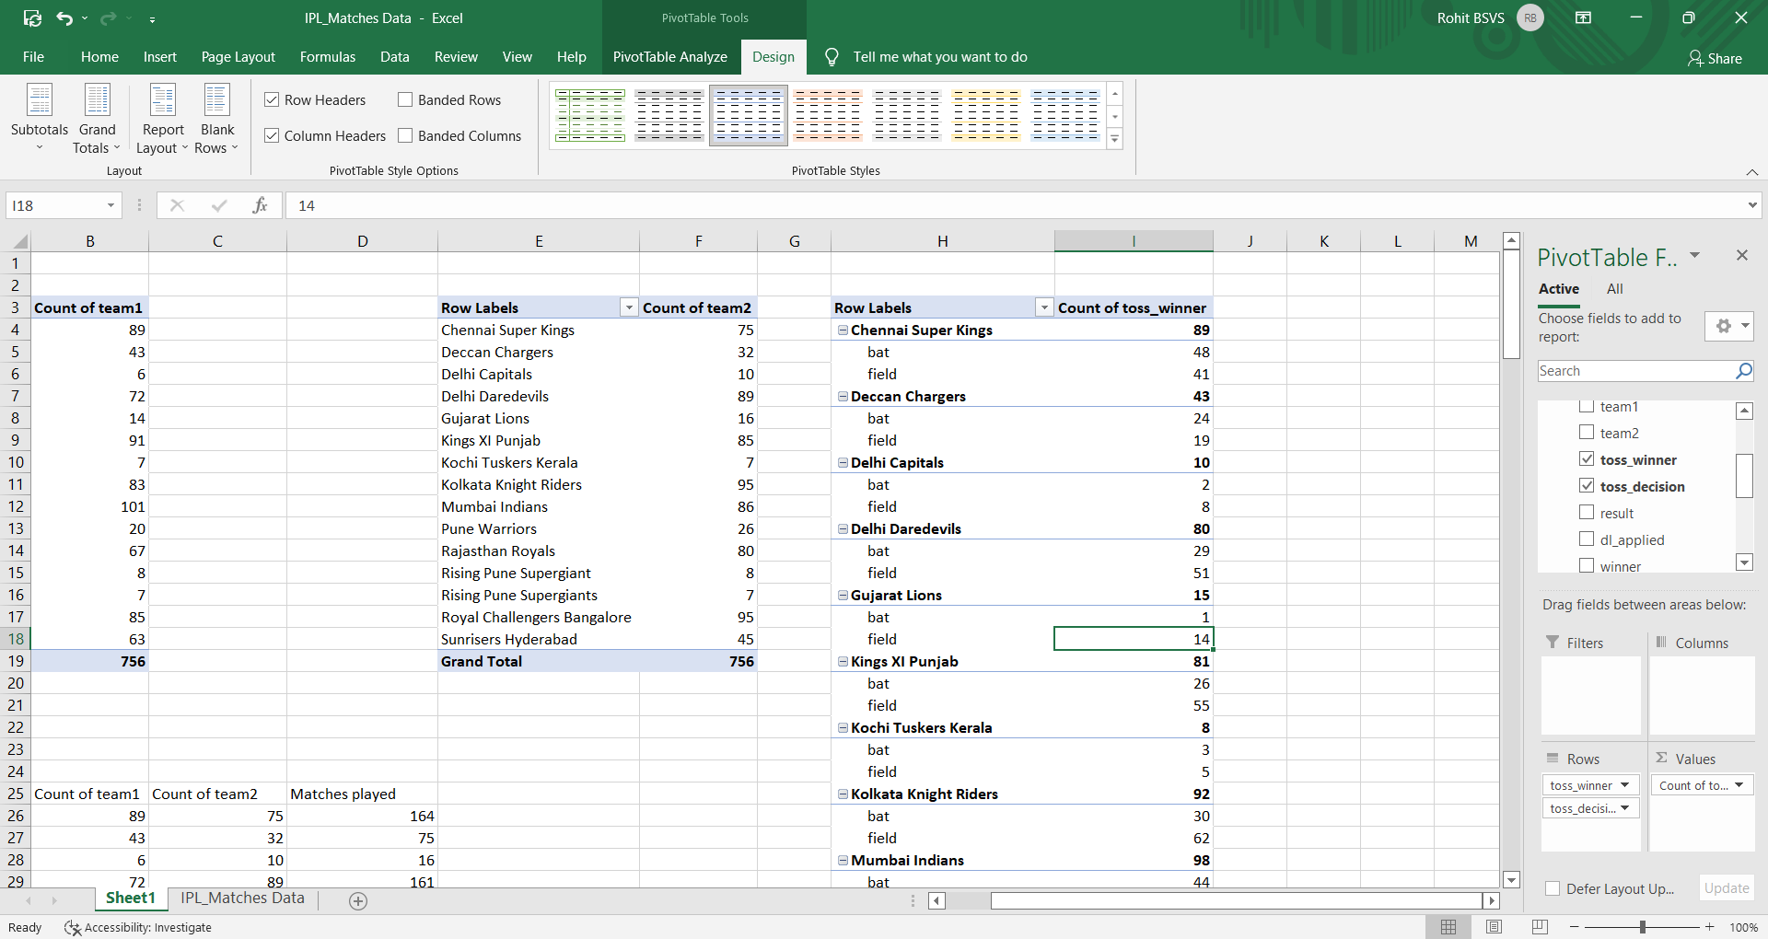

Slide 20
SO HERE WE USED PIVOT TABLE TO CALCULATE AND COMPARE THE TOSS_WINNER AND TOSS_DECISION BY DOING SO WE GET THE TABLE OF EACH TEAM WHO WON THE TOSS AND ALSO THE DECISION THEY TOOK AFTERING WINNING IT.

Slide 21
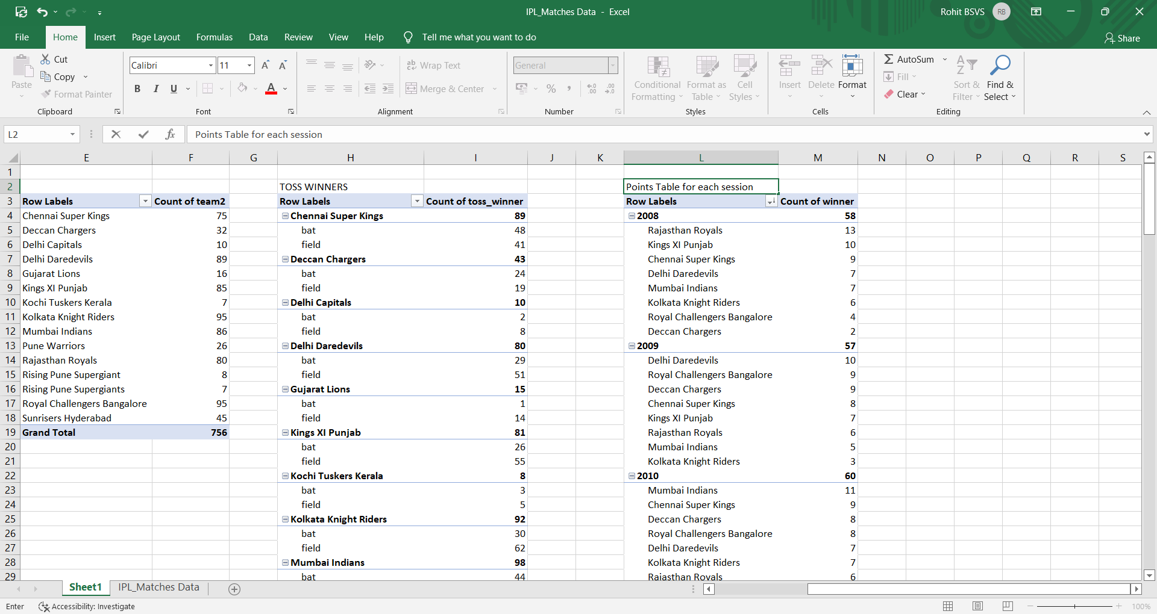

Slide 22
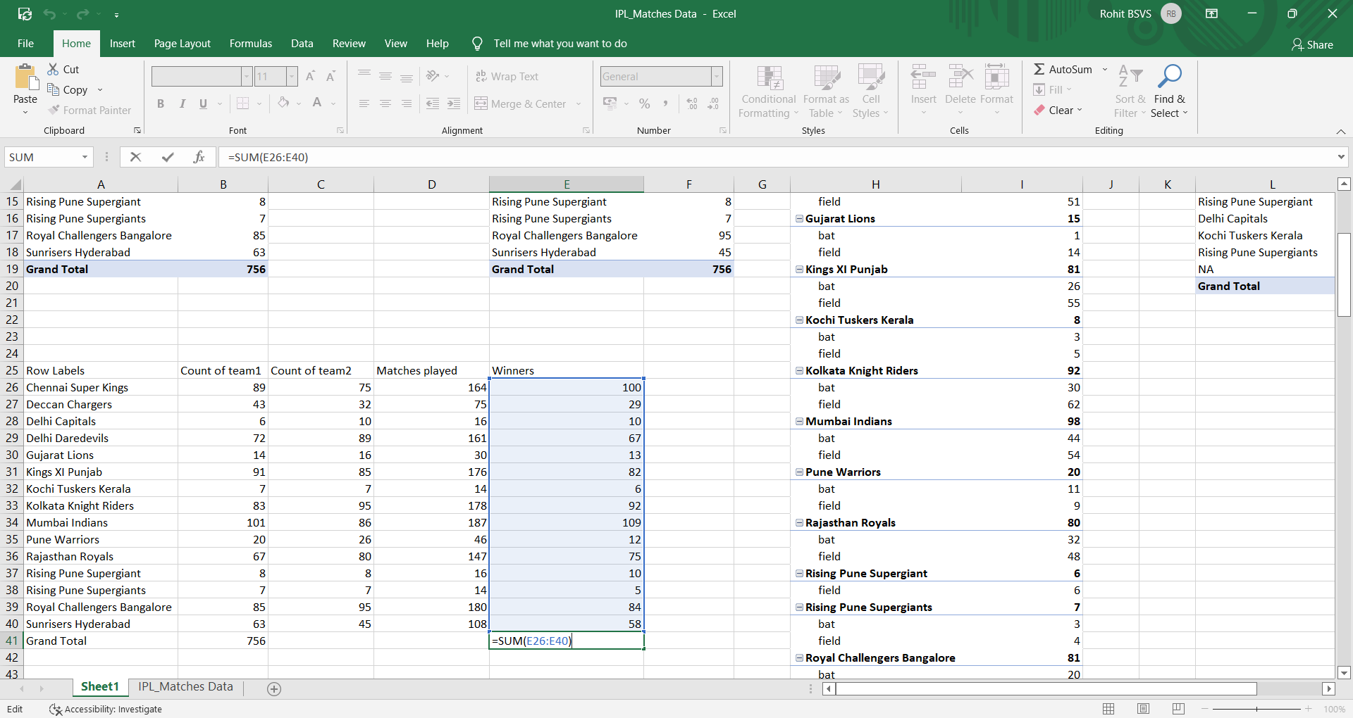

Slide 23
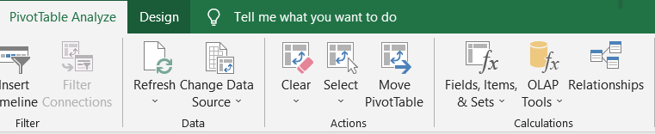
OLAP
In Excel, you can connect to OLAP cubes (often called multidimensional cubes) and create interesting and compelling report pages with Power View. To connect to a multidimensional data source, from the ribbon select Data > Get External Data > From Other Sources > From Analysis Services.

Slide 24
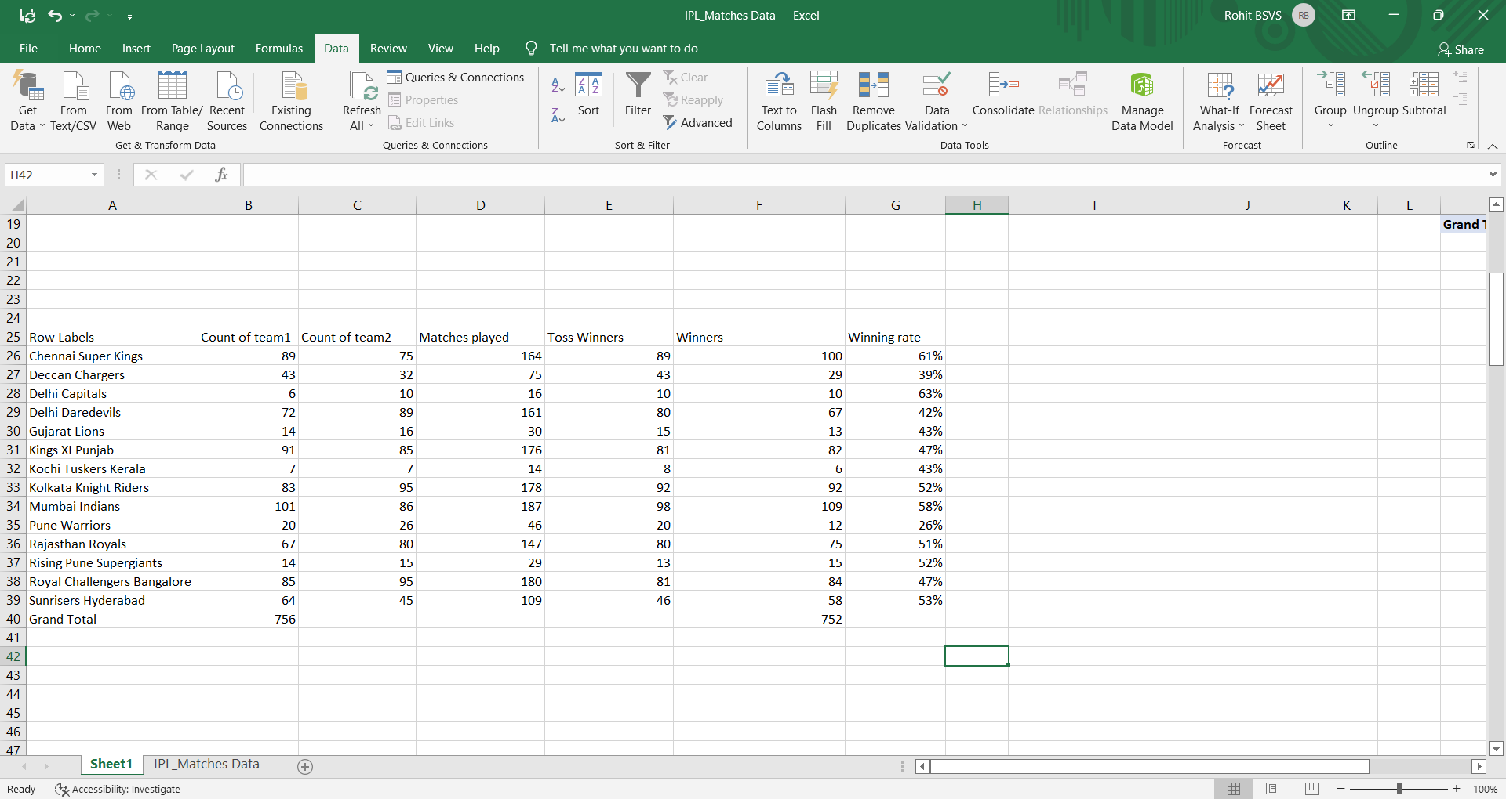

Slide 25
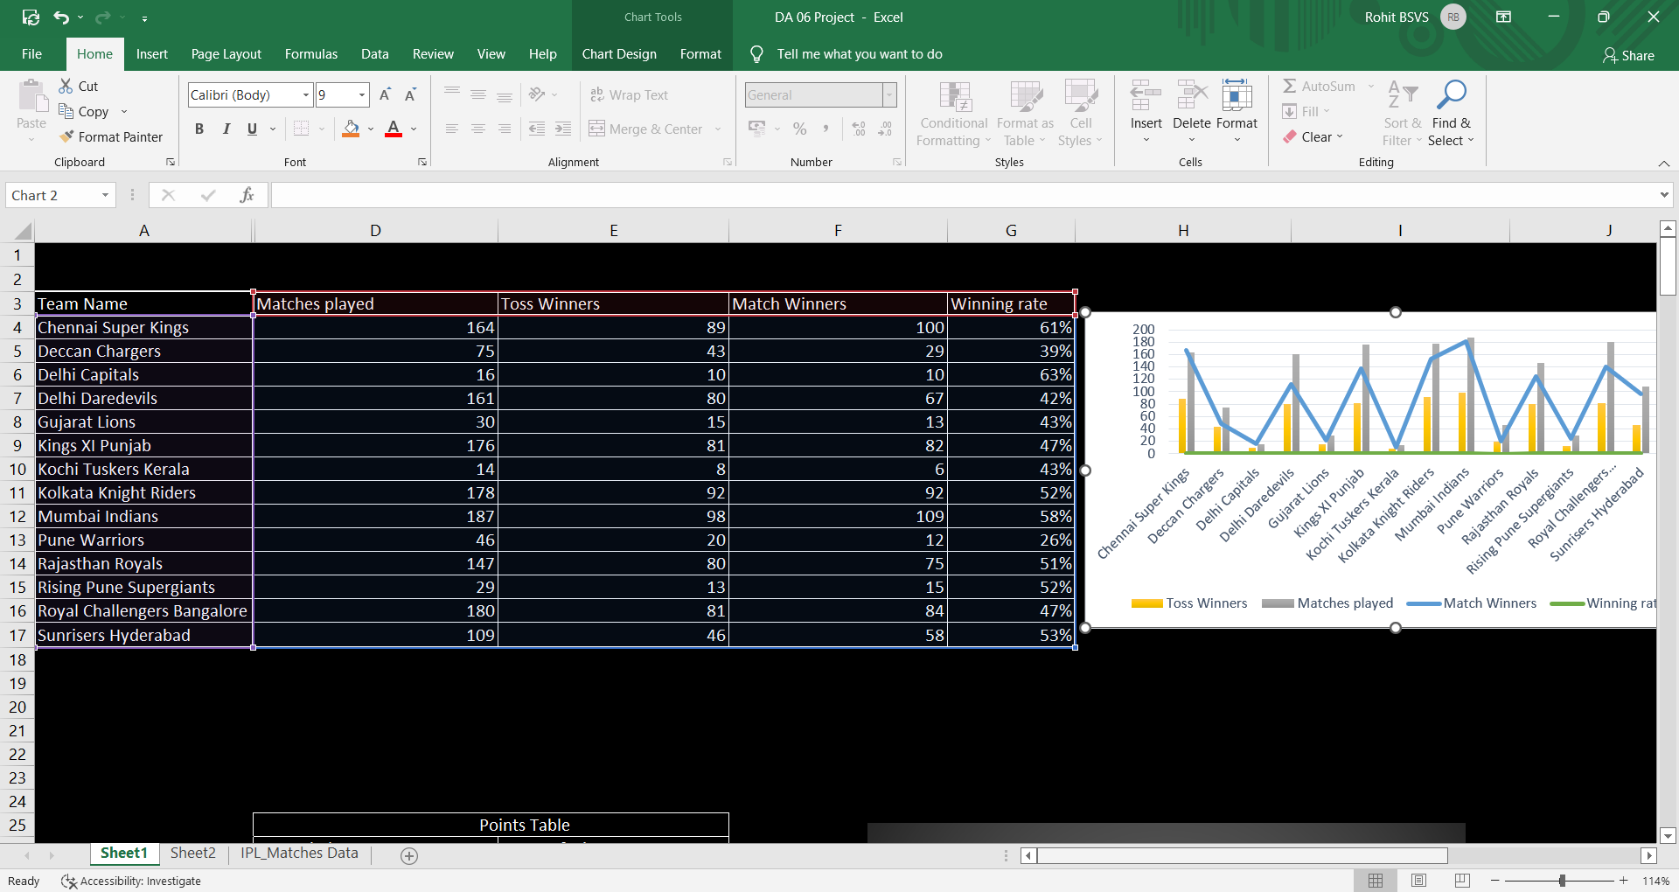

Slide 26
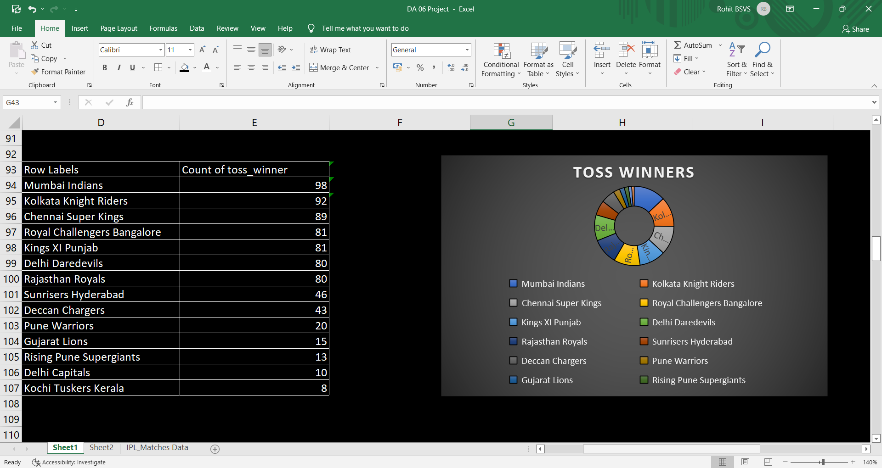

Slide 27
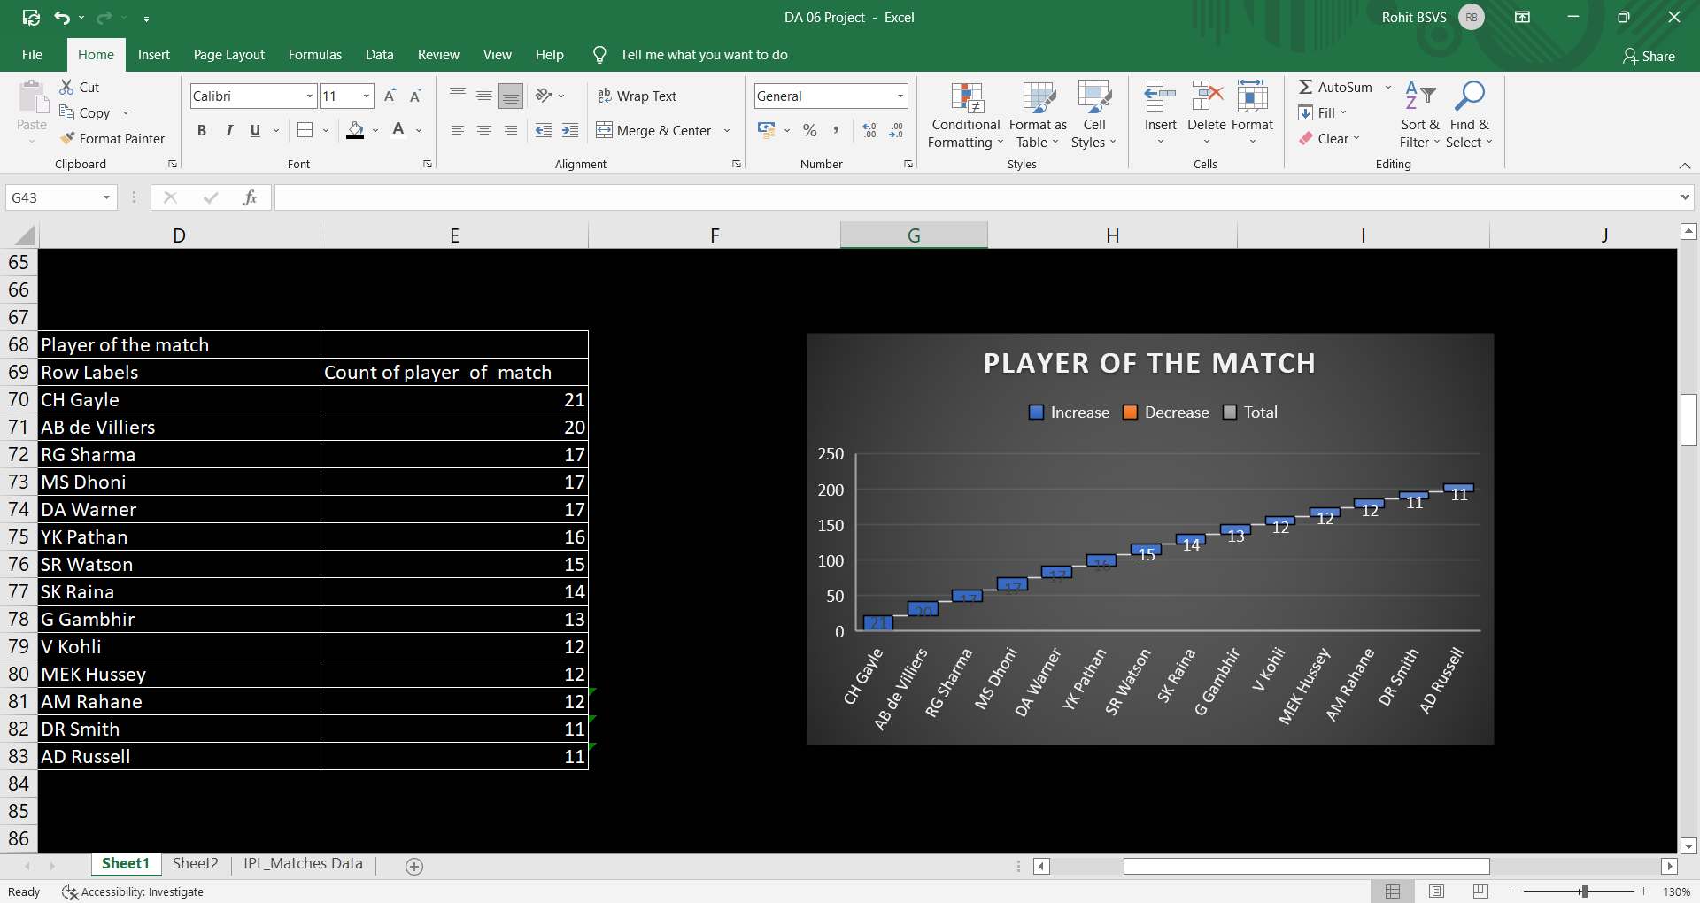

Slide 28
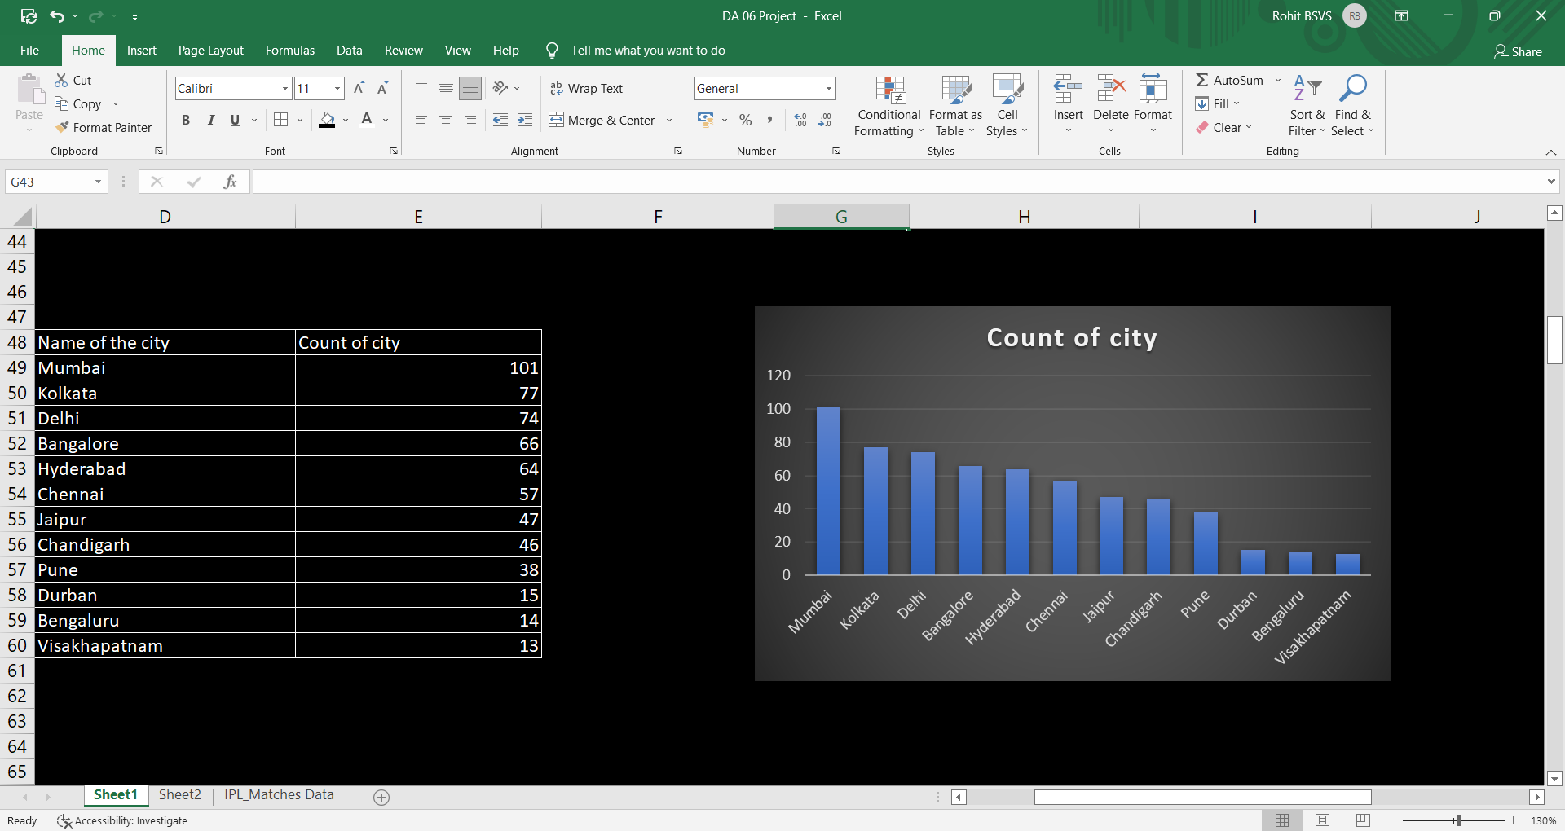

Slide 29
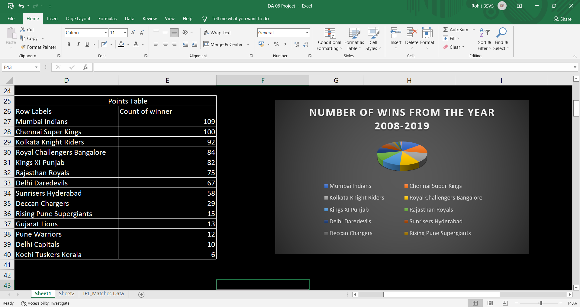

Slide 30


